Slide 1
OMSA Election Voting Procedure

Slide 2
Voting
For voting go to https://omsa.org.in/search.php or scan the QR Code given below

Slide 3
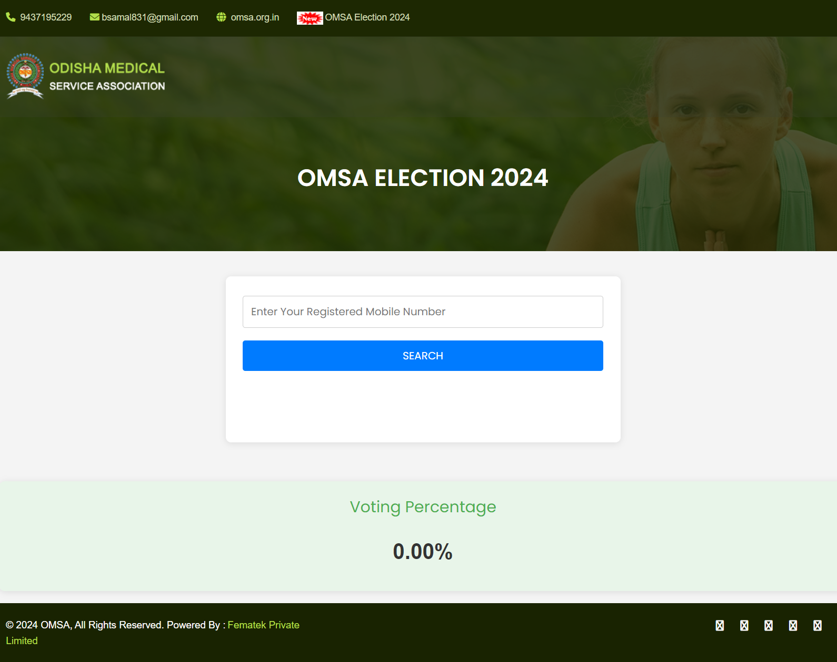
Voting
After clicking on the link or scanning the QR code, a page will be displayed. Enter you registered mobile number & Click on Submit Button to procced for voting.

Slide 4
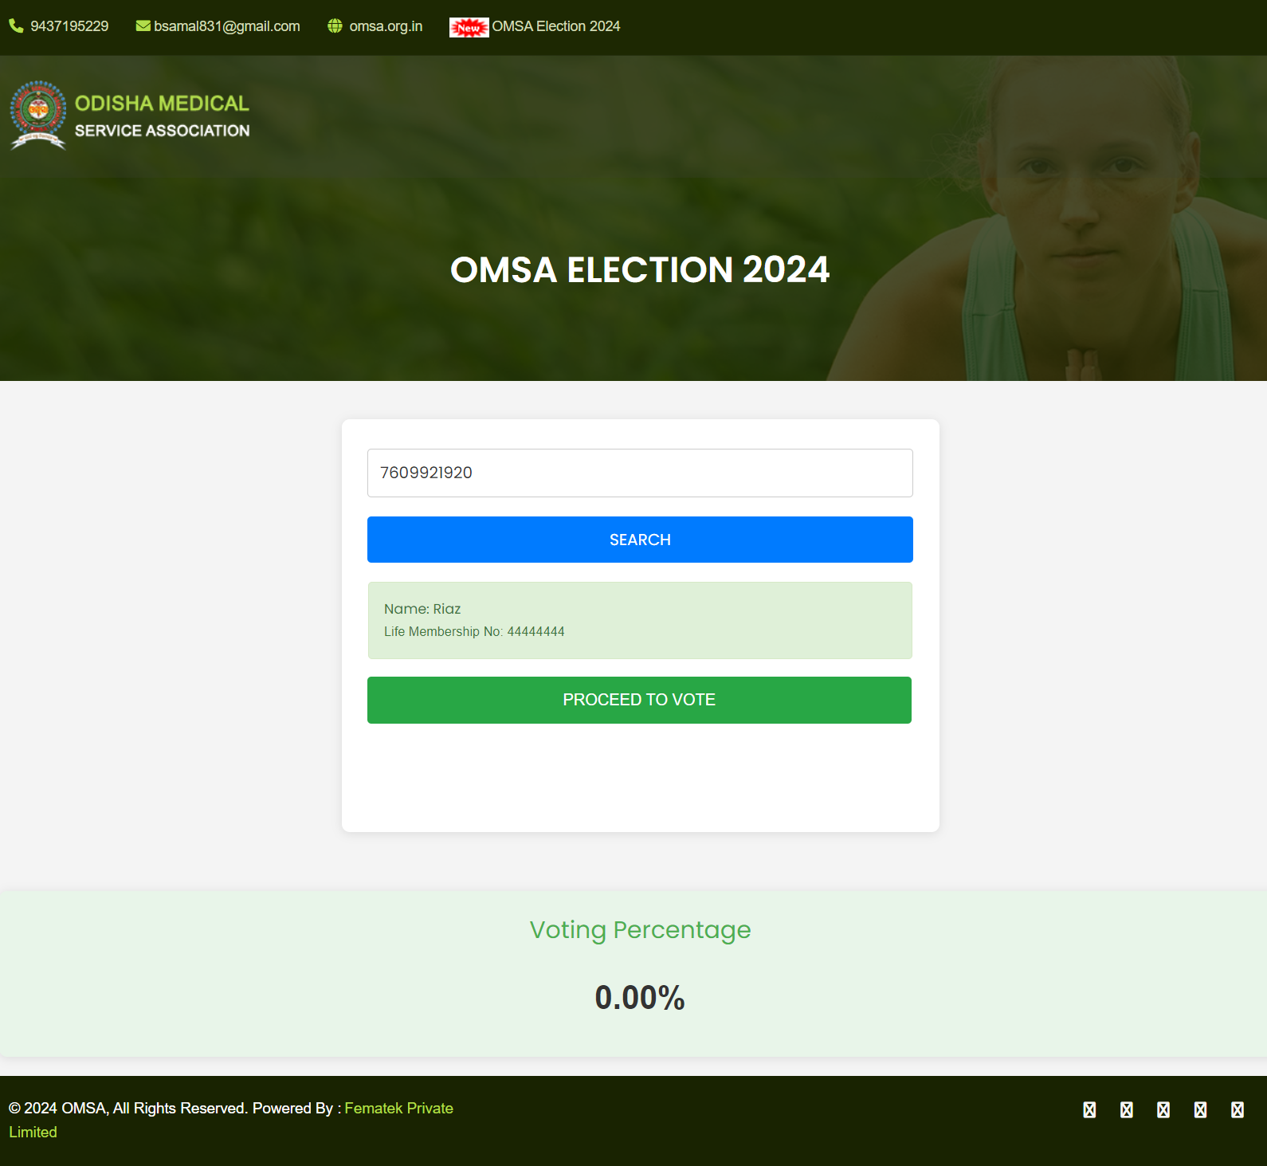
Voting
After entering your number & clicking on submit button a page will be displayed with your details. Then click on Proceed To Vote button for voting.

Slide 5
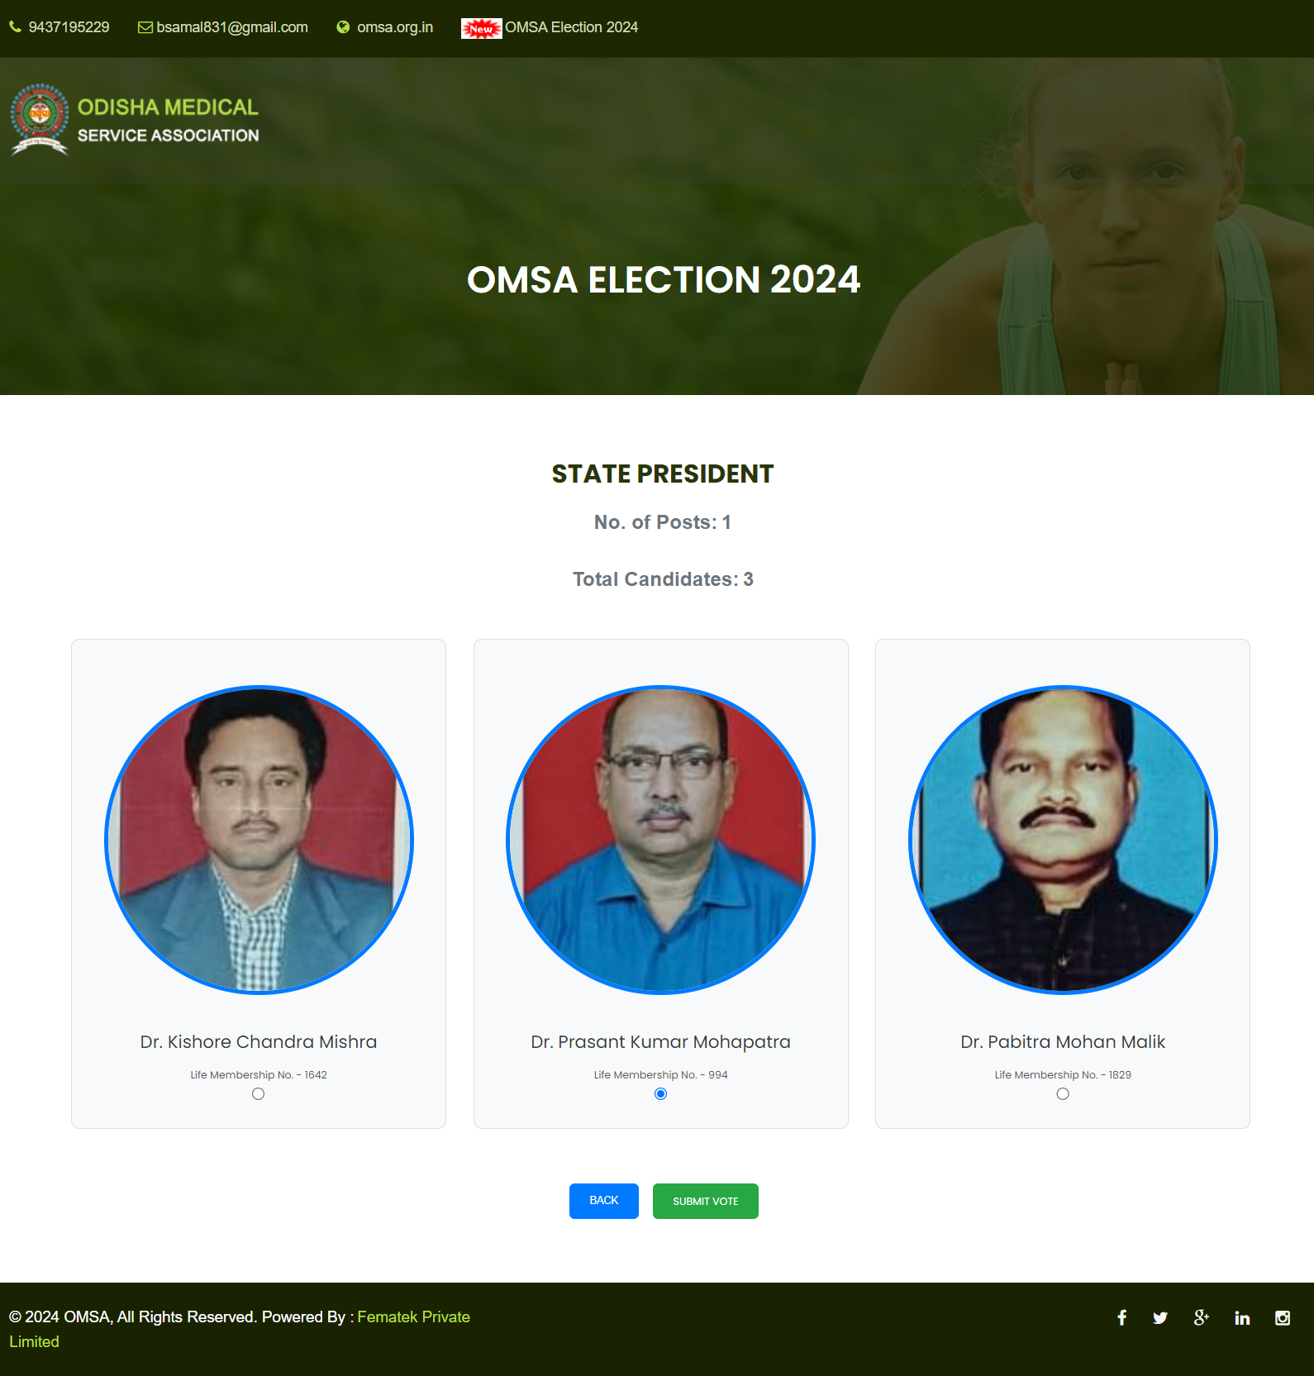
Voting
Select the desired candidate you want to cast your vote.

Slide 6
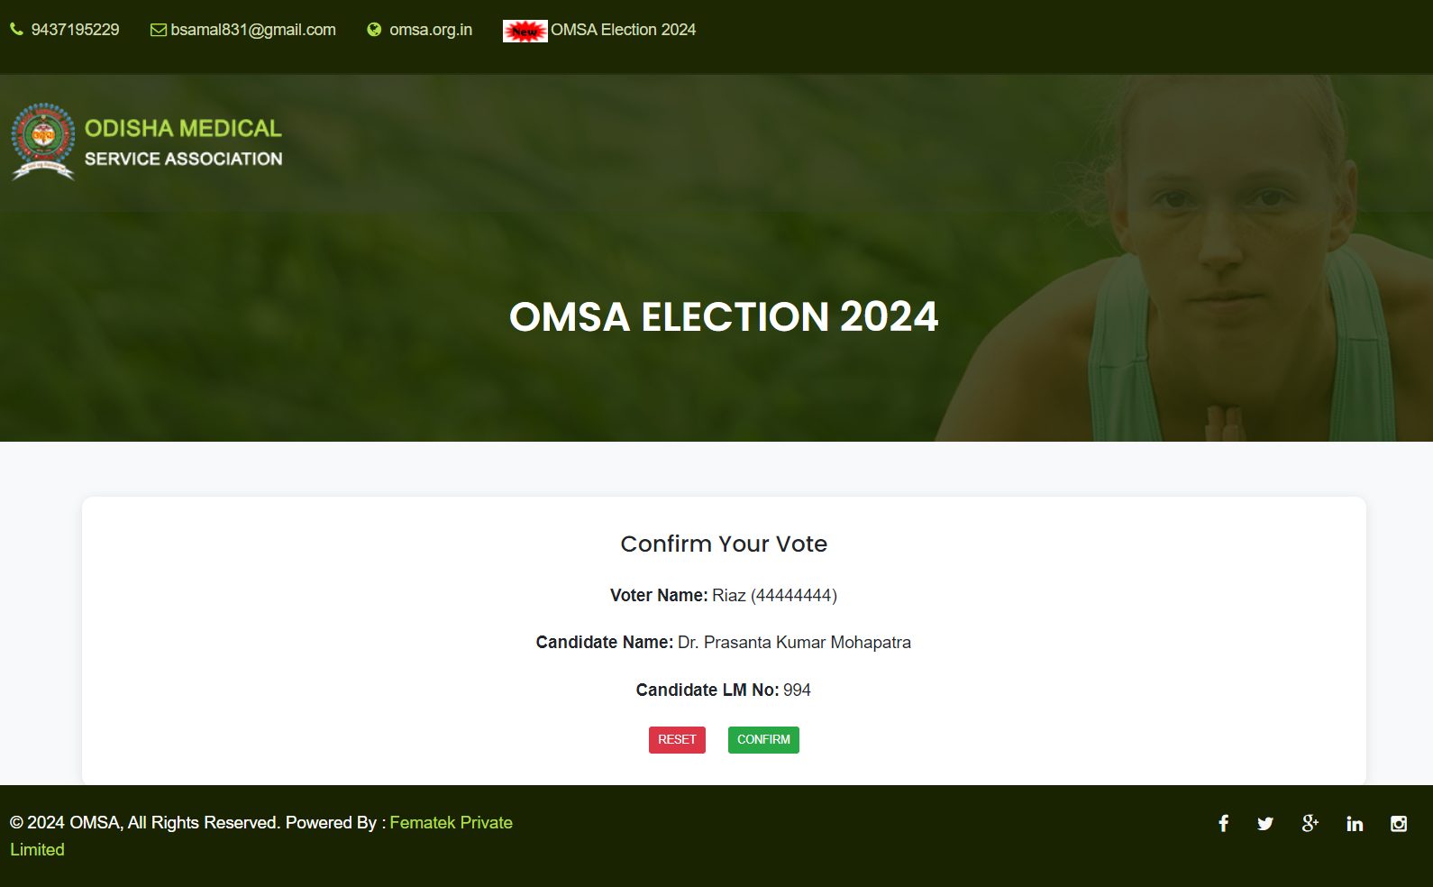
Voting
After click on Submit Vote a new page will be displayed to check your voting selection. If you have selected any wrong candidate you can click on Reset Vote to reselect candidates or click on Conform to complete your voting process.

Slide 7
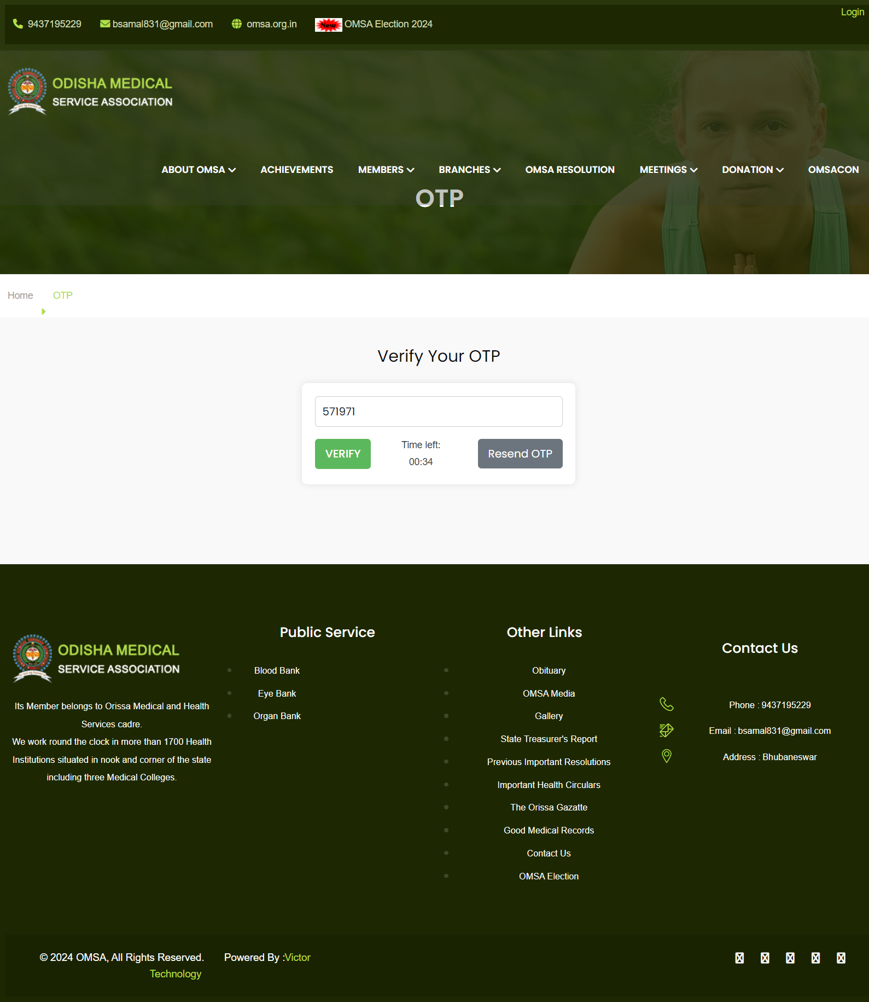
Voting
After clicking on Submit Vote BTN a OTP will be sent to your registered mobile number. Enter the OTP and click on Submit button.

Slide 8
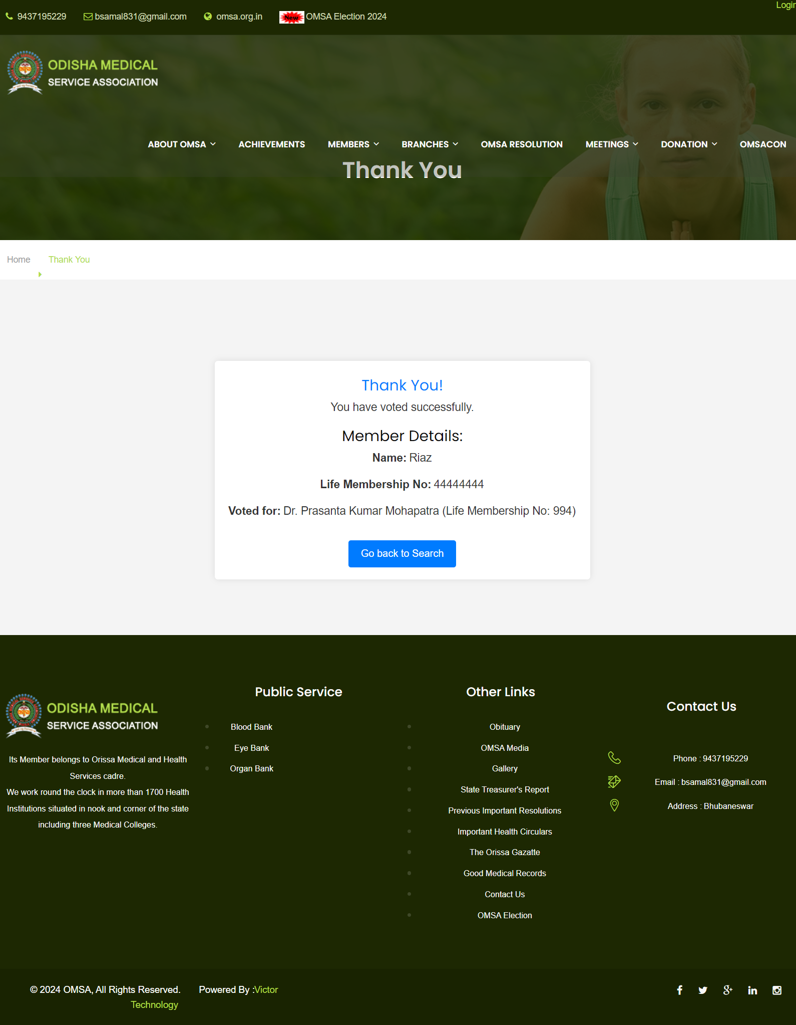
Voting
After entering the OTP & clicking on Submit button a Thank You message will be displayed along with the name of the candidates you have voted.

Slide 9
Thank you for Watching
Presented By
Fematek Private Limited

